Slide 1





Predictive analytics S&P 500 sector returns vs economic indicators
Holly shirmenzagas, Daniel Jackson, Nathan phillips, Daniel ”DC” Carrillo

Slide 2

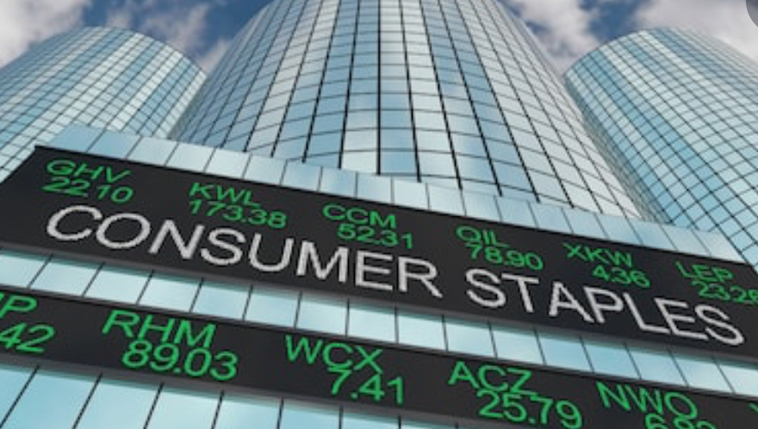


We looked at s&p 500 sector data
Consumer Discretionary Consumer Staples Energy Financial Health Industrial Energy Materials Technology Utilities

Slide 3




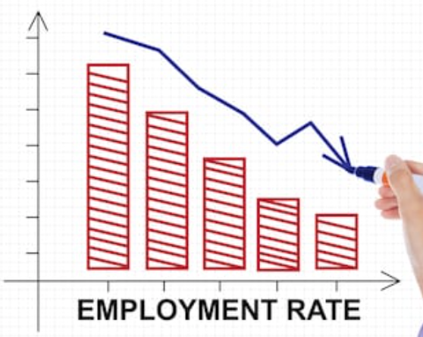
We looked at specific economic indicators
Typical Economic Indicators Unemployment Import/Export Index Consumer Price Index Producer Price Index
Atypical Economic Indicators Cardboard pricing Superbowl AFC/NFC Beer pricing Cosmetics prices Crime scene investigation Underwear prices Haircut pricing

Slide 4
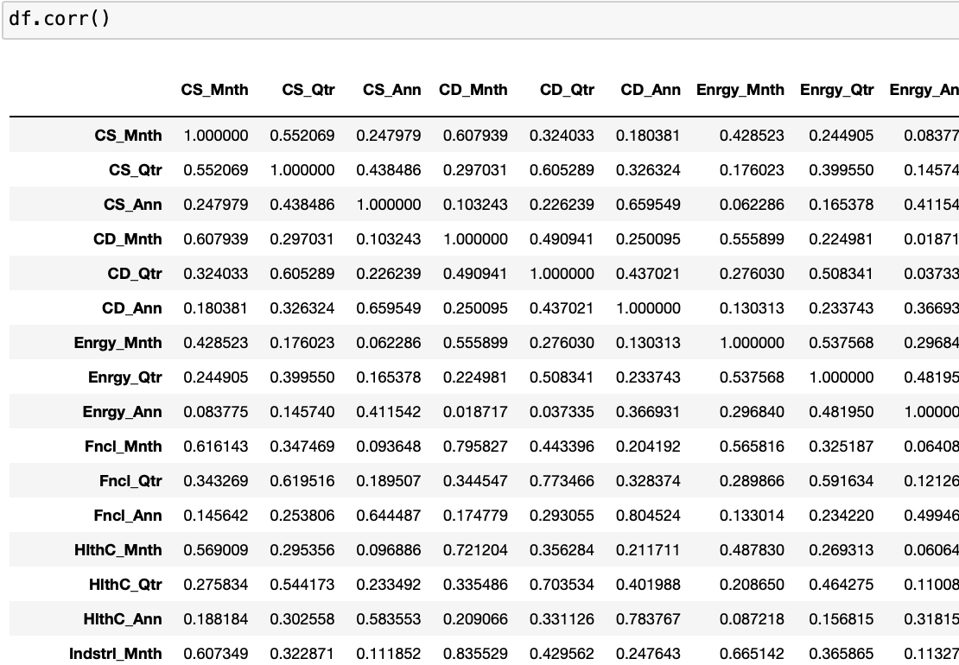
Initial linear regression models
We used a very simple approach for initial visualizations of the data with linear regression
We specifically observed correlations of our data sets as a cursory overview

Slide 5
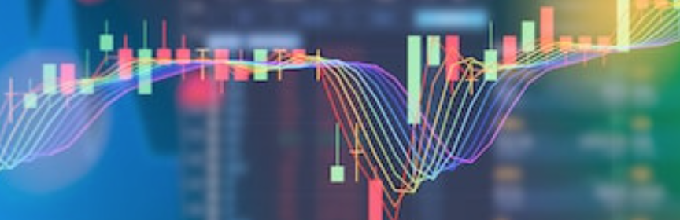
Empowered Predictive analysis with sklearn

Slide 6
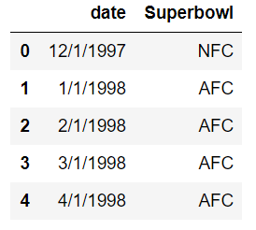
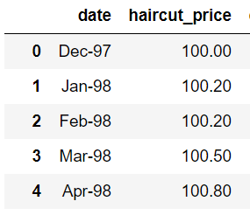
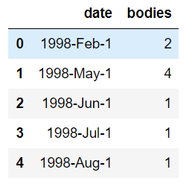
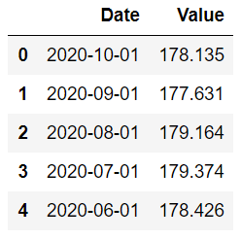
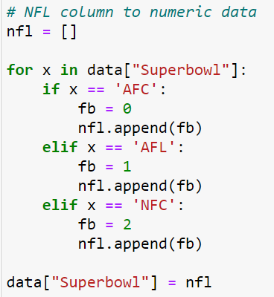
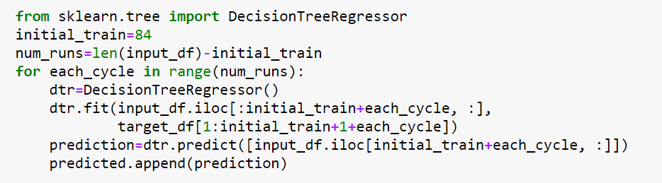
The process

Slide 7
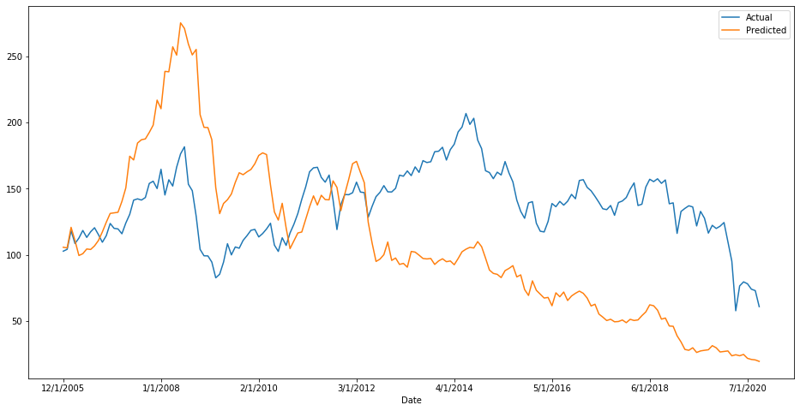
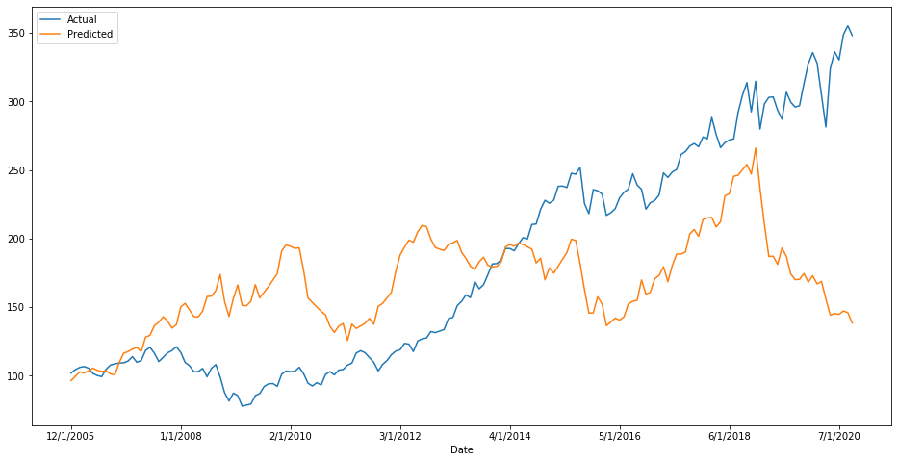
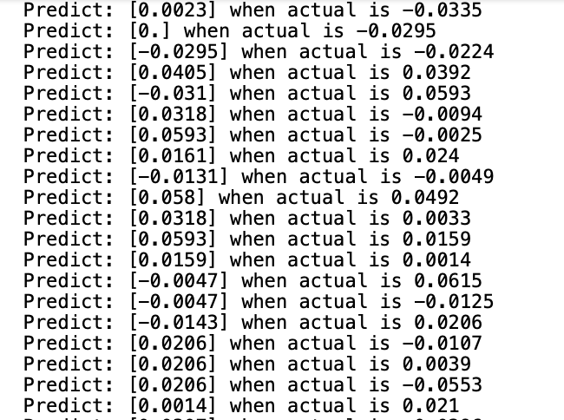
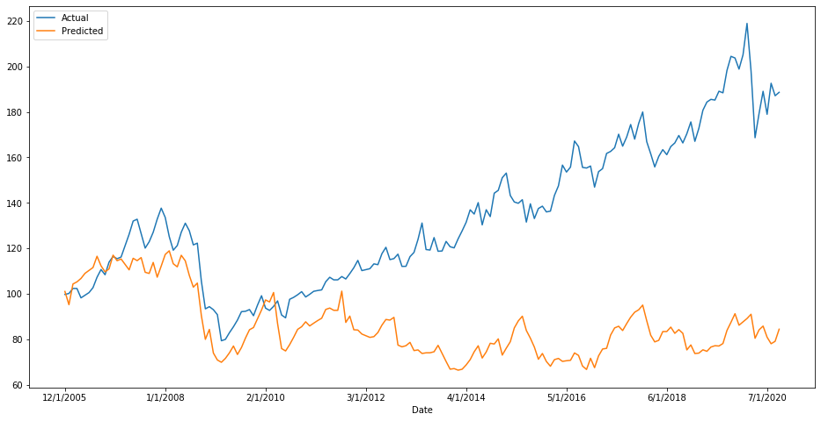
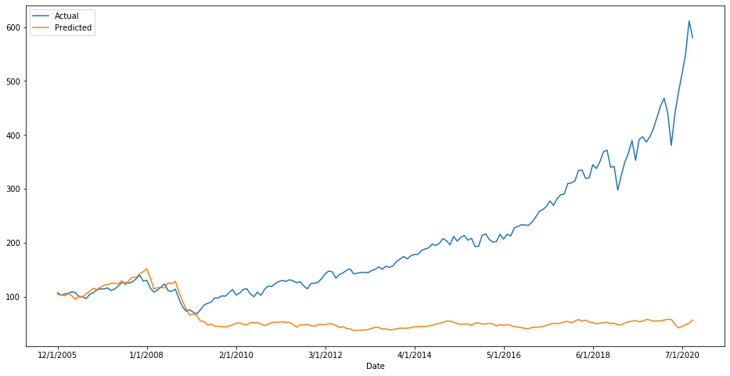
Algorithm & back-testing
Predictive data with Sklearn
Predictive data visualized with Matplotlib
Energy
Health Care
Utilities
Technology

Slide 8

Tableau visualizations

Slide 9
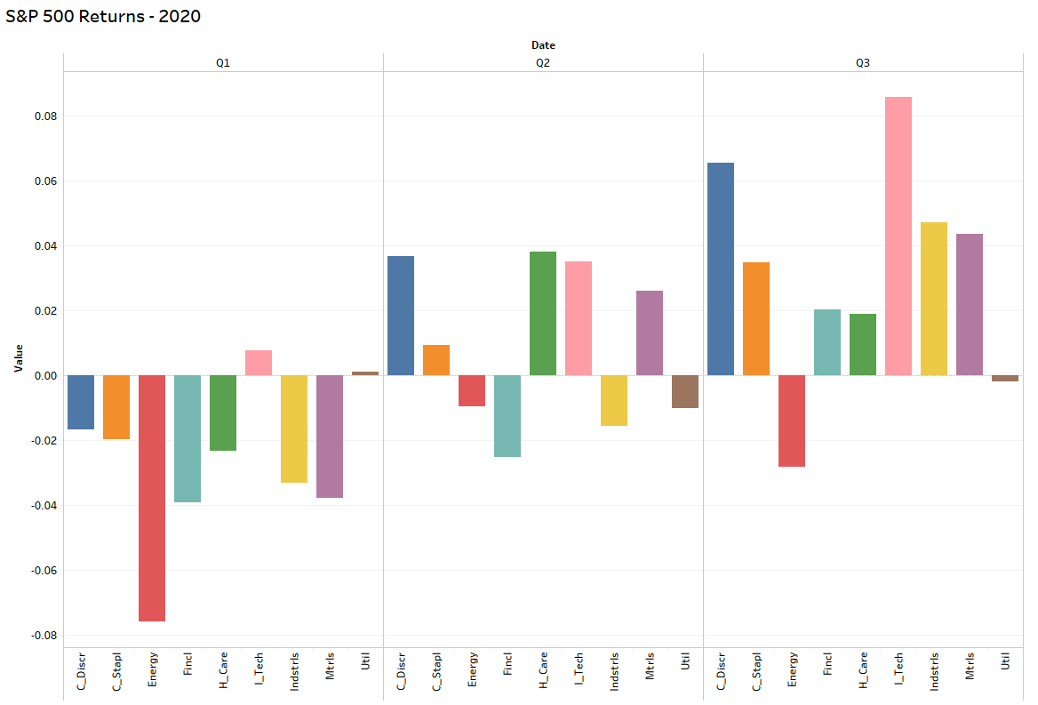
S&P 500 Returns - First three quarters of 2020
You can see the sectors in the market take a turn for the better beginning in Q2 as the US recovered from the COVID-19 lockdowns.
Energy is Red
Tech is Pink

Slide 10
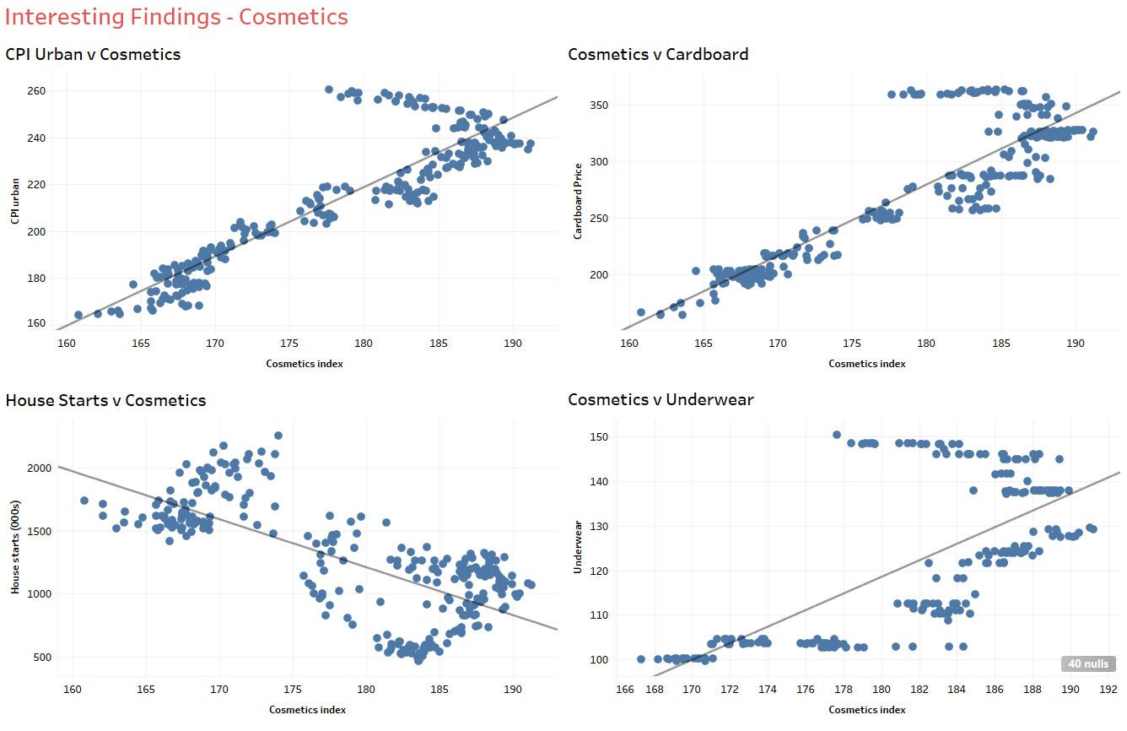
Interesting findings - cosmetics
The independent variables were not only mostly correlated to one another, there was a clear relationship with some of the more traditional indices like the Consumer Price Index and Housing Starts

Slide 11

HTML Development

Slide 12

HTML Discussion
Initial page
Explanation of atypical indicators and why they are important

Slide 13

to be continued…

